Slide 1
Structures in C
A structure is a user defined data type in C/C++. A structure creates a data type that can be used to group items of possibly different types into a single type.

Slide 2
Union in C
Like Structures, union is a user defined data type. In union, all members share the same memory location.

Slide 3
How to create a structure?
‘struct’ keyword is used to create a structure. Following is an example.
struct address
{
char name[50];
char street[100];
char city[50];
char state[20];
int pin;
};

Slide 4
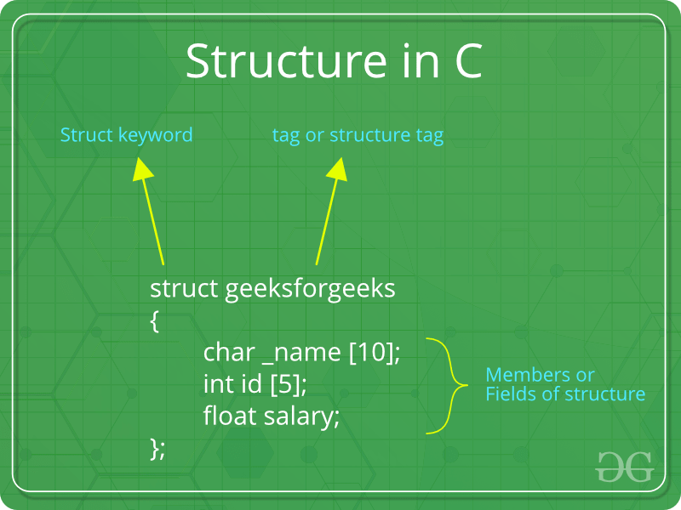

Slide 5
